Slide 1
Harnessing Large Language Models for
Training-free Video Anomaly Detection
Luca Zanella, Willi Menapace, Massimiliano Mancini, Yiming Wang, Elisa Ricci
Presenter: Sunghyun Ahn
Department of Computer Science, Yonsei University
skd@yonsei.ac.kr
Notes:
Hello everyone, I am sunghyun ahn from Data Engineering Lab.
Today, I will present CVPR paper, Harnessing Large Language Models for Training-free Video Anomaly Detection.

Slide 2
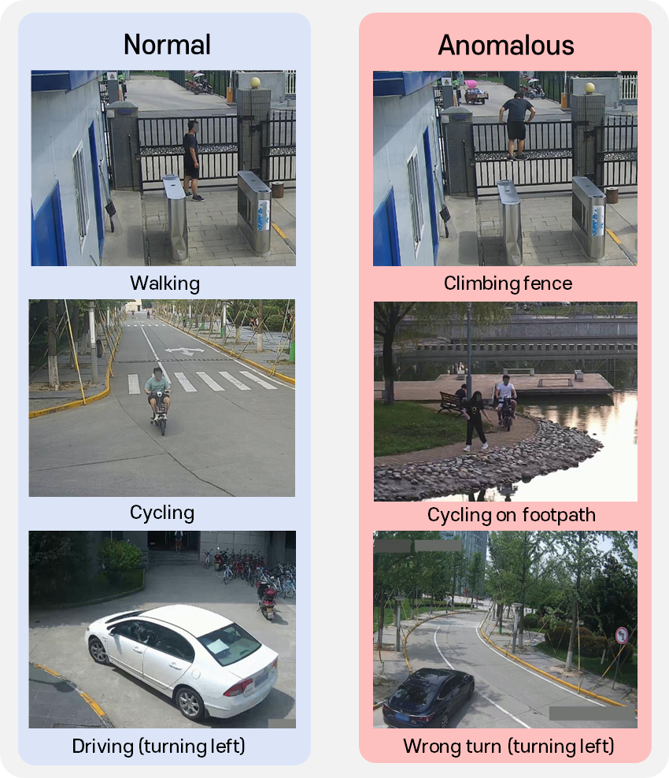
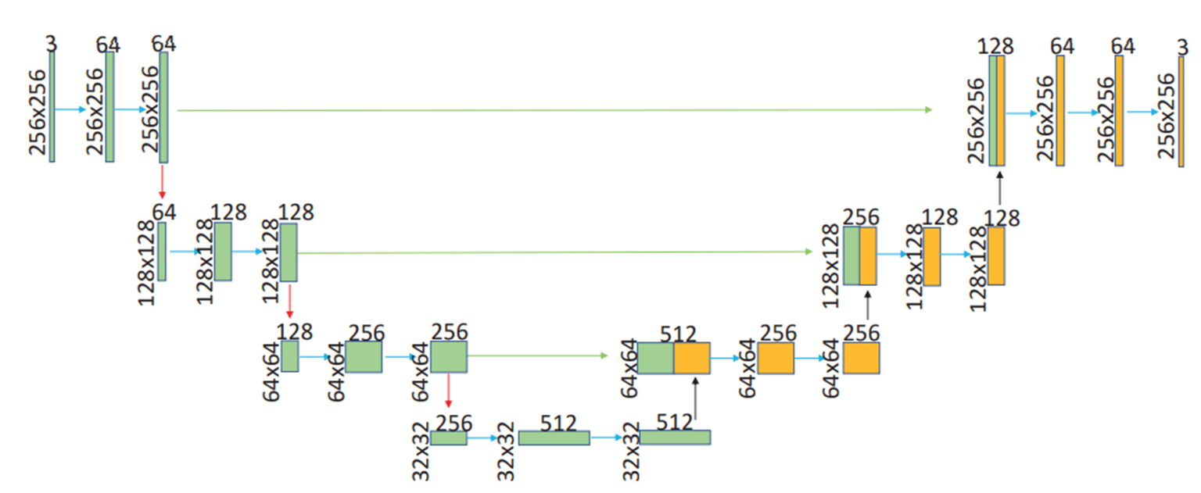
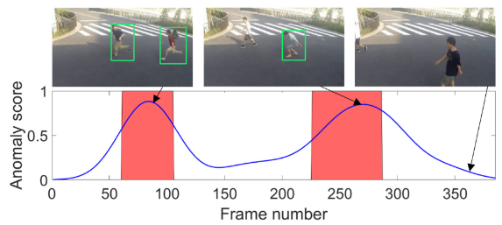
Introduction
Video Anomaly Detection
Video Anomaly Detection (VAD) aims to identify abnormal events within video streams
Abnormal events include the appearance or behavior of objects that are not suitable for the situation
VAD has high annotation costs, various effective training methods are used, not just supervised learning
AI Model
Notes:
Video anomaly detection called VAD, aims to identify abnormal events within video stream.
So, The objective is for the AI model to produce a high anomaly score when it receives an abnormal frame and a low anomaly score when it receives a normal frame.
And abnormal events include the appearance or behavior of objects that are not suitable for the situation.
Most of video targets are CCTV, which usually focuses on pedestrian walkways and roads. So, Normal activities can include walking, cycling, and driving. Abnormal activities include climbing fences, cycling on footpaths, and wrong turns.
But, As you can imagine, due to the high cost of annotations, VAD utilizes various effective training methods beyond supervised learning.

Slide 3
Introduction
Four Training Methods
Fully Supervised: frame-level normal/abnormal annotations in the training data
One-class: only normal training data
Weakly-supervised: video-level normal/abnormal annotations
Unsupervised: no training data annotations
Zaheer, M. Zaigham, et al. "Generative cooperative learning for unsupervised video anomaly detection." Proceedings of the IEEE/CVF conference on computer vision and pattern recognition. 2022.
Notes:
So, there are four training methods. Firstly, the fully supervised method utilizes frame-level annotations for normal or abnormal event in the training data. The one-class method only uses normal training data. The weakly supervised method relies on video-level annotations, while the unsupervised method does not use annotated training data. However, as mentioned before, the fully supervised method is difficult to collect data for, so efforts are now focused on developing the other training methods.

Slide 4
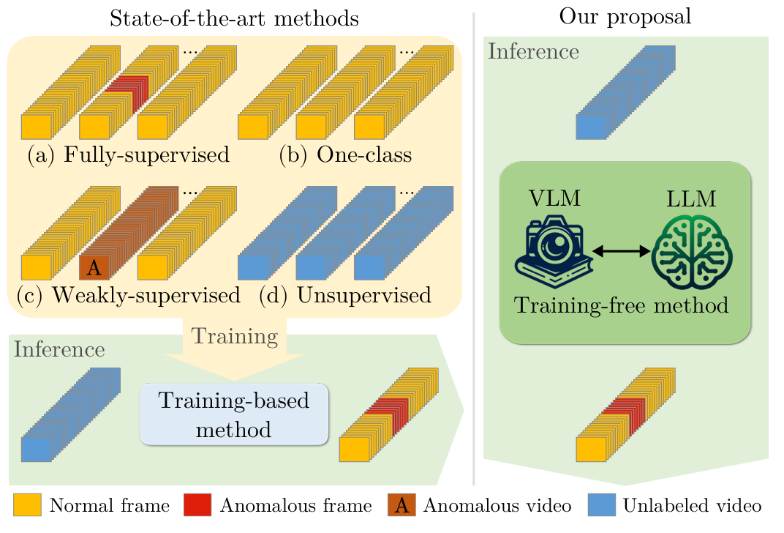
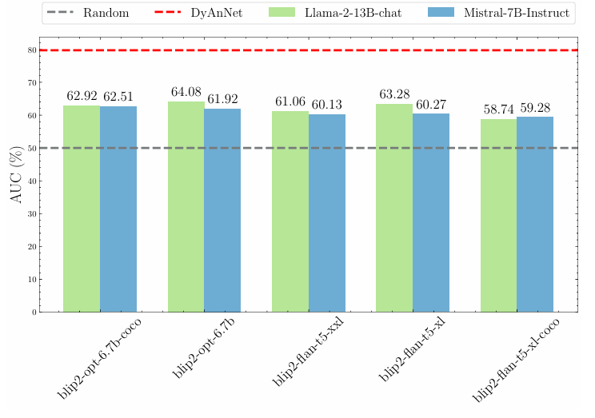
Introduction
Language-based VAD
Propose Language-based VAD (LAVAD) using only LLM and VLM without training
Using VLM (BLIP) and LLM (LLaMA) directly results in lower performance compared to unsupervised methods
Address the issue of insufficient performance when using VLM and LLM directly
Notes:
But, this method, called language-based VAD, utilizes LLM and VLM without any training. Essentially, BLIP can be used to extract captions for each frame, and then LLAMA can calculate ANOMALY scores based on these captions for VAD. However, these straightforward methods perform worse than unsupervised methods. Therefore, the authors of this paper addressed the underperformance issue.

Slide 5
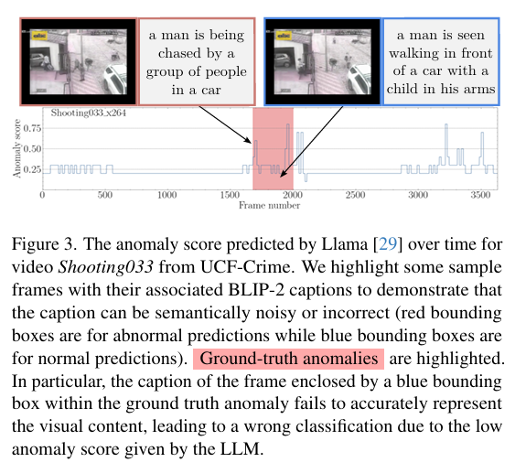
Introduction
Limitations of Frame-level caption
Incorrect captions may occur (captions unrelated to the frame, normal captions extracted via abnormal frames)
Difficult to secure global context (i.e. running vs chased), lack of dynamic information in the scene (i.e. standing vs loitering)
Notes:
The paper highlights two main problems with frame-level captioning.
First, incorrect captions can occur. As shown in the picture below, you might see captions that don't match the frame or normal captions generated from abnormal frames.
Second, it's difficult to capture global and dynamic information. For example, it's hard to tell from a single frame whether a person is running or being chased. Similarly, you can't easily determine if a person is just standing or loitering at just one frame.

Slide 6
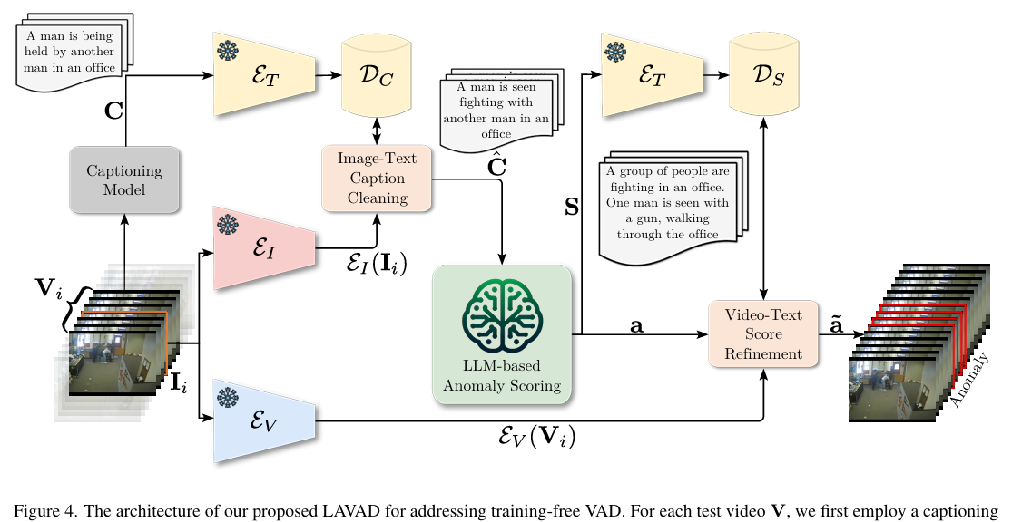
Method
Language-based VAD
Image-Text Caption Cleaning resolves noisy caption issues
LLM-based Anomaly Scoring addresses the limitations related to lack of scene dynamics
Video-Text Score Refinement improves performance by refining anomaly scores
Notes:
To address these problems, the authors propose three solutions.
First, Image-Text Caption Cleaning to resolve noisy caption issues.
Second, LLM-based Anomaly Scoring to tackle the lack of scene dynamics problem. Third, Video-Text Score Refinement to improve performance by refining the anomaly score.

Slide 7
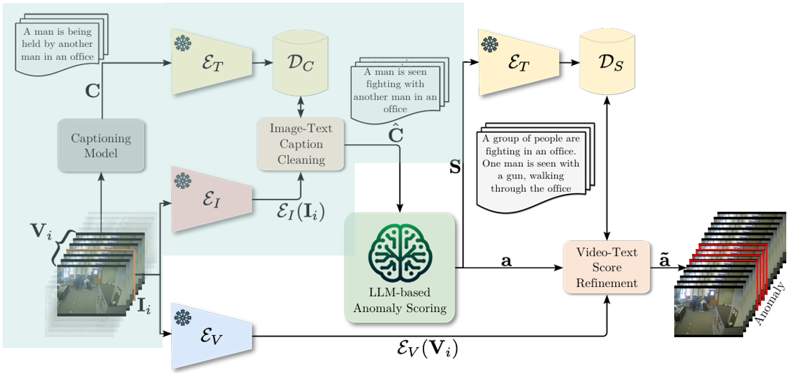
Method
Image-Text Caption Cleaning
Assume the existence of captions that better capture visual content among surrounding frames
Replace the caption with text features that best correspond to the visual features of the frame
Obtains more accurate frame captions (e.g., being held vs fighting)
Notes:
In Image-Text Caption Cleaning, the authors make an assumption: even if a caption is incorrect for a certain frame, there will be captions from nearby frames that better describe the visual content.
So, they compare the visual features of the frame with all available text features and replace the original caption with the text that has the highest cosine similarity.
This method helps get more accurate frame captions. For example, if a frame shows people fighting, a caption saying “a man is being held" would be replaced with “a man is seen fighting“.

Slide 8
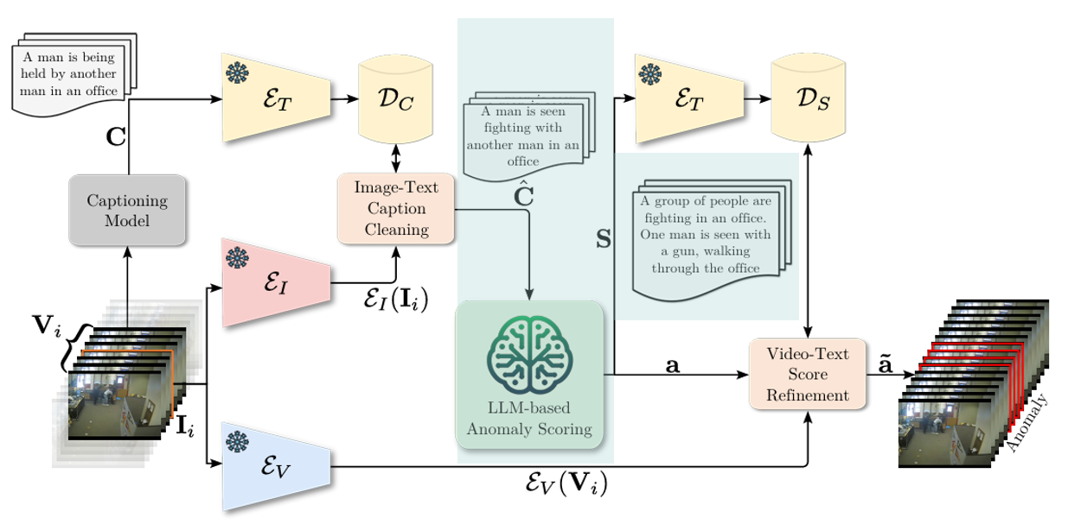
Method
P_{S} “Please summarize what happened in few sentences, based on the following temporal description of a scene.”
P_{C} “If you were a law enforcement agency, how would you rate the scene described on a scale from 0 to 1,with 0 representing a standard scene and 1 denoting a scene with suspicious activities?”
P_{f} “Please provide only one number in the provided list below [0, 0.1, 0.2, 0.3, 0.4, 0.5, 0.6, 0.7, 0.8, 0.9, 1.0]. ”
LLM-based Anomaly Scoring
Perform summarization and scoring processes using LLM
Summarize captions of surrounding frames (V_{i}) to obtain global and dynamic context
Provide prompts for VAD to output an anomaly score (0-1)
Notes:
In LLM-based anomaly scoring, there are two main tasks: summarization and scoring.
First is summarization. Since the caption for only one frame cannot capture global and dynamic context, the authors summarize the captions of the surrounding frames Vi​. This is done using an LLM with a prompt Ps​. For example, using the prompt, "Please summarize what happened in a few sentences, based on the following temporal description of a scene," along with the captions Ci for Vi​, the LLM produces a summary that includes dynamic information. Each generated summary Si becomes the updated caption for the frame.
Next is scoring. The generated Si​ is used by the LLM to calculate an anomaly score. Two prompts are used here. The first prompt Pc provides context for the VAD task. For example, "If you were a law enforcement agency, how would you rate the scene described on a scale from 0 to 1, with 0 representing a standard scene and 1 denoting a scene with suspicious activities?" The second prompt Pf provides an output template, for example, "Please provide only one number in the provided list below [0, 0.1, 0.2, 0.3, 0.4, 0.5, 0.6, 0.7, 0.8, 0.9, 1.0].“
Through this process, the authors can perform anomaly scoring using dynamic information.

Slide 9
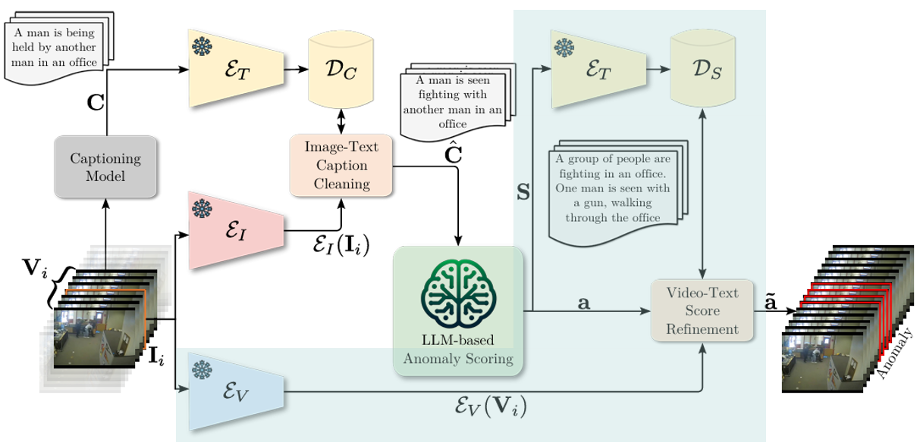
Method
Video-Text Score Refinement
Based on the summary of V_{i} (S_{i}), the initial Anomaly Score (a_{i}) may be inaccurate
Because summaries are not always accurate, so the entire score set must be considered
Find k summaries semantically closest to V_{i} and compute a weighted sum of anomaly scores corresponding to those summaries
Notes:
The final method is video-text score refinement.
The initial anomaly score Ai​ is based on the summary of Vi​, and it can be inaccurate because summaries are not always correct.
So, the authors argue that the entire score set should be considered.
This method is similar to the caption cleaning described earlier. First, video features for Vi​ are extracted using a video encoder.
and, similarity between the video features and text features of the summary are calculated to select k semantically similar summaries. Afterward, the anomaly score corresponding to these selected summaries are weighteded and used to replace the original anomaly score.
Through this approach, by leveraging more meaningful summary information, refined anomaly scores can be obtained.

Slide 10
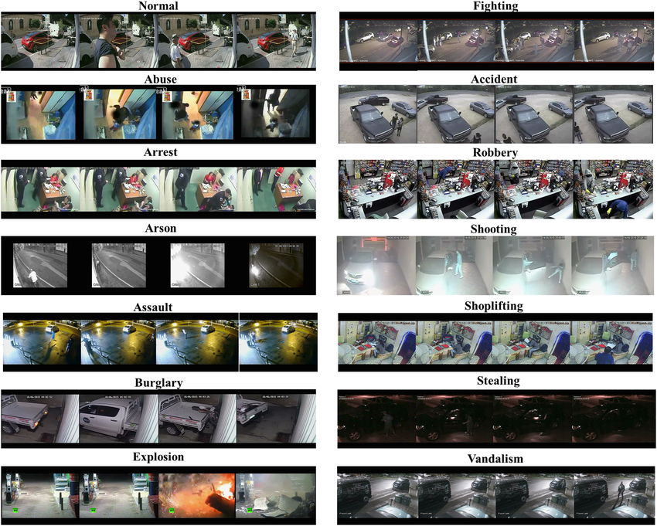
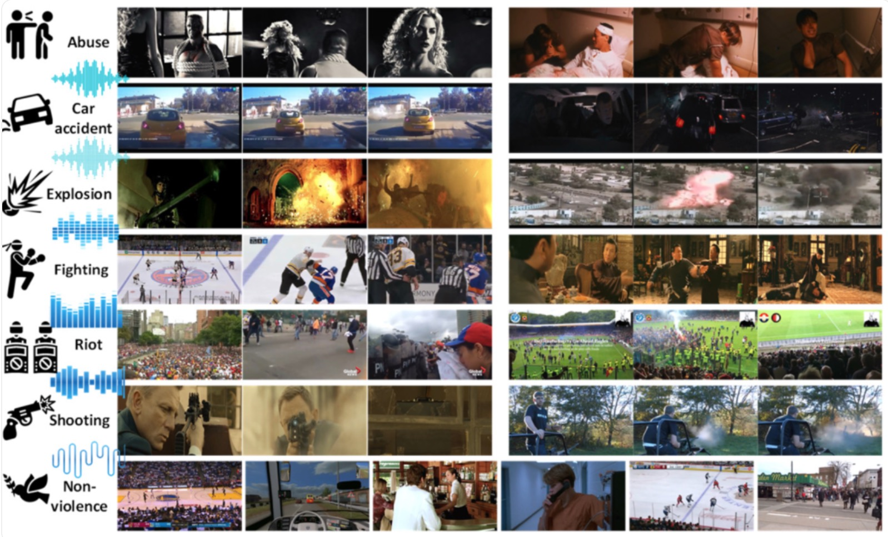
Experiments
Datasets
UCF-Crime is a large-scale dataset that is composed of 1900 long untrimmed real-world surveillance videos
XD-Violence is another large-scale dataset for violence detection, comprising 4754 untrimmed videos that are collected from both movies and YouTube
Notes:
Next is the experimental part. In this paper, Authors utilized two datasets: UCF-Crime and XD-Violence.

Slide 11
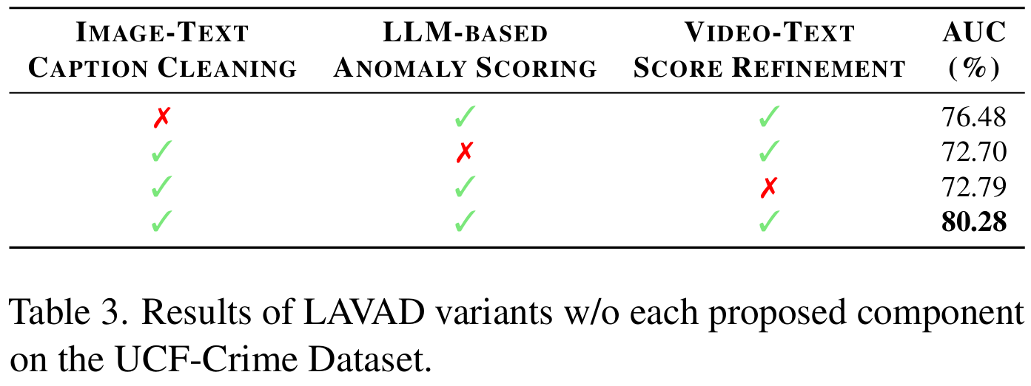
Experiments
Ablation study
When the Image-Text Caption Cleaning component is omitted, the performance degrades by −3.8%
Skipping temporal summary and relying only on cleaned captions with refinement leads to a −7.58% drop
Using only temporal summary anomaly scores on cleaned captions, without aggregating similar frames, leads to a −7.49% drop
Notes:
First, the authors conduct ablation study.
When the Image-Text Caption Cleaning component is omitted, the performance degrades by −3.8%.
Skipping temporal summary and relying only on cleaned captions with refinement leads to a −7.58% drop.
Lastly, Using only temporal summary anomaly scores on cleaned captions, without aggregating similar frames, leads to a −7.49% drop.

Slide 12
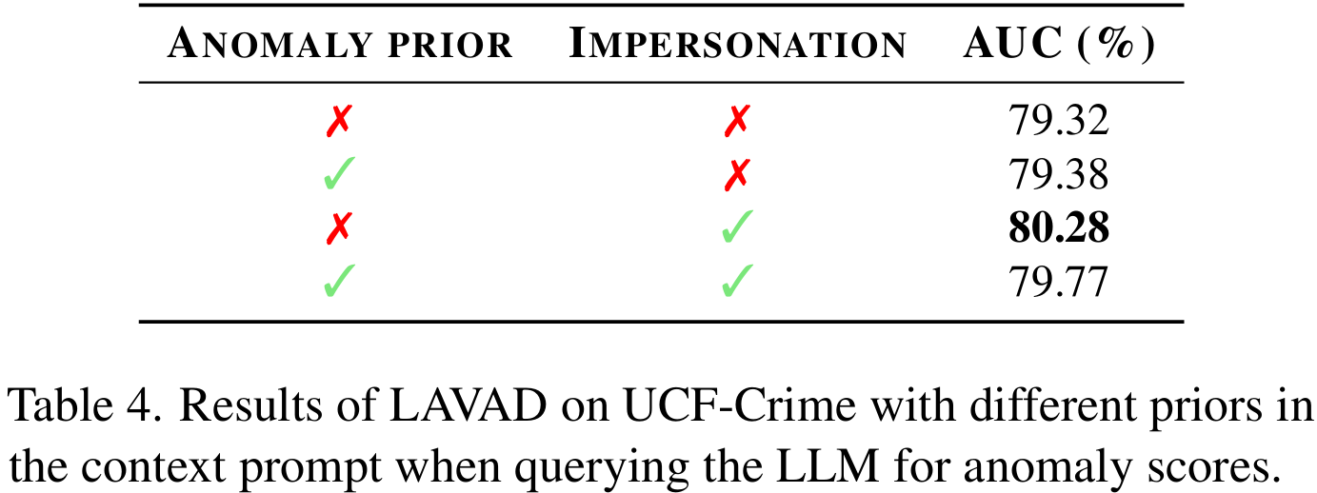
Experiments
Ablation study
Investigate the impact of different priors in the context prompt P_{c}
Incorporating both priors does not further boost the AUC
More stringent context might limit the detection of a wider range of anomalies
BASE PROMPT: “How would you rate the scene described on a scale from 0 to 1, with 0 representing a standard scene and 1 denoting a scene with suspicious activities?”
ANOMALY PRIOR: “or potentially criminal activities”
IMPERSONATION: “If you were a law enforcement agency,”
Notes:
And they also investigate the impact of different priors in the context prompt. Priors can be seen on the right screen, and anomaly priors can be added to the base prompt. Impersonation can also be added to the base prompt at the beginning.
The authors find that incorporating both priors does not further boost the AUC. They said, "More stringent context might limit the detection of a wider range of anomalies."

Slide 13
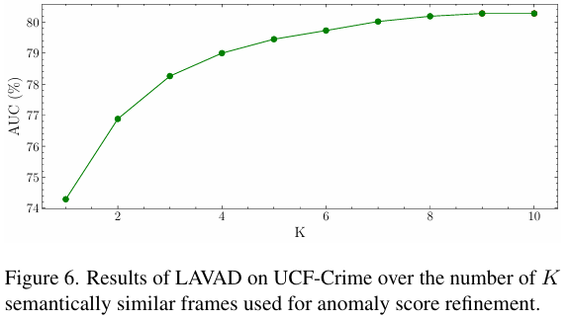
Experiments
Ablation study
Investigate how the VAD performance changes in relation to the number of semantically similar temporal summaries
AUC metric consistently increases as K increases
Considering similar frames improves the accuracy of VAD
Notes:
Lastly, they investigate how the VAD performance changes in relation to the number of semantically similar temporal summaries.
Consequently, AUC consistently increases as K increases, and show including similar frames boosts VAD accuracy.

Slide 14
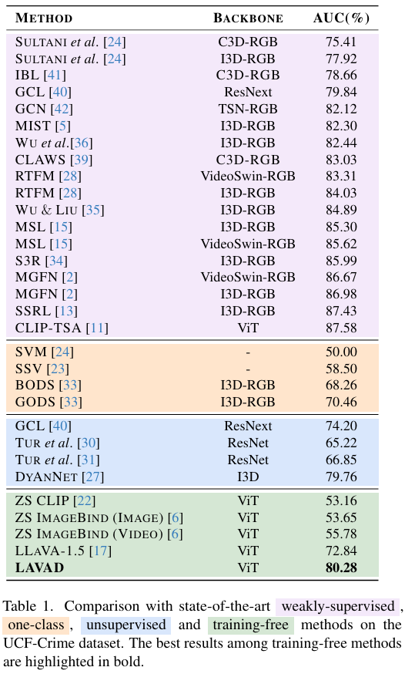
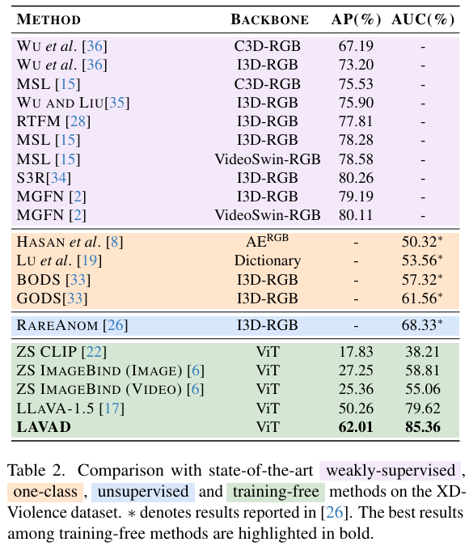
Experiments
Comparison with state of the art
Notably, LAVAD without any training demonstrates superior performance compared to both the one-class and unsupervised baselines
Notes:
And, when they compare LAVAD with SOTA models, They demonstrates superior performance compared to both the one-class and unsupervised baselines.

Slide 15
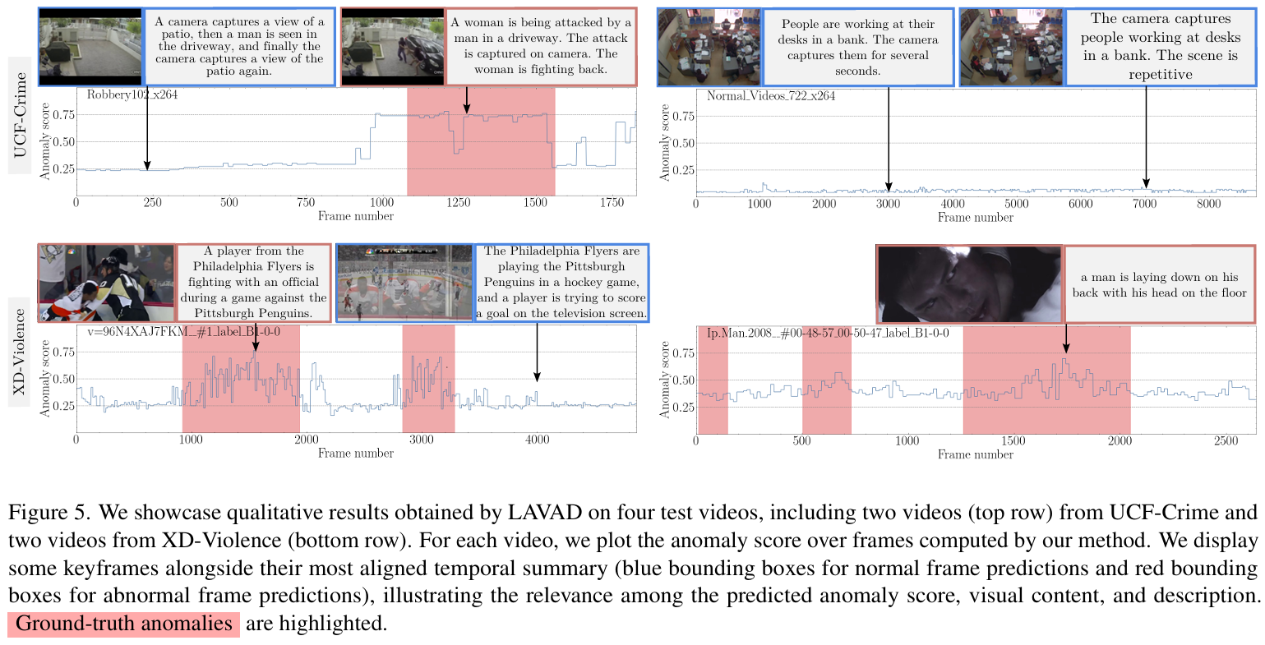
Experiments
Qualitative Results
LAVAD correctly detect the anomaly scene in the three abnormal videos
In the case of Normal_Videos_722, LAVAD consistently predicts a low anomaly score throughout the video
Notes:
In Qualitative Results, LAVAD correctly detect the anomaly scene in the three abnormal videos. And In the case of Normal_Videos, LAVAD consistently predicts a low anomaly score throughout the video.

Slide 16
Conclusions
Language-based VAD
Introduce LAVAD, a pioneering method to address training-free VAD
Demonstrate superior performance compared to training methods in unsupervised and one-class setting
Expected to significantly contribute to VAD, where data collection is difficult
Notes:
So, The authors introduce LAVAD, a pioneering method to address training-free VAD. And they demonstrate superior performance compared to training methods in unsupervised and one-class setting.
This work is expected to significantly contribute to VAD, where data collection is difficult

Slide 17
Thank you
Notes:
Thank you!

