Slide 1
Dual Stream Fusion U-Net Transformers for
3D Medical Image Segmentation
Seungkyun Hong⋆, Sunghyun Ahn⋆, Youngwan Jo, Sanghyun Park†
Department of Computer Science, Yonsei University
Seoul, Republic of Korea
{highsk, skd, jyy1551, sanghyun}@yonsei.ac.kr
⋆ Equal contribution
† Corresponding author
Notes:
Hello everyone, I am sunghyun ahn from yonsei university korea.
Today, I am going to present our work, Dual Stream Fusion U-Net Transformers for 3d medical image segmentation. This is joint work with seungkyun hong and youngwan jo and my advisor sanghyun park.

Slide 2
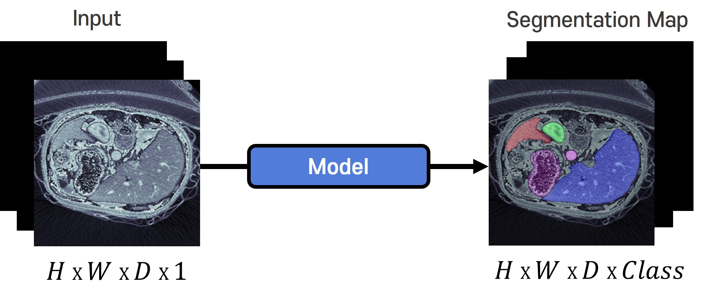
Introduction
3D Medical Image Segmentation
Distinguishing lesions, tumors, and organs in complex 3D CT or MRI images
Supervised learning is utilized to create a segmentation map indicating tissue location for each pixel
Utilized in medical diagnostics, surgical support, disease research, demanding accuracy and promptness
Notes:
so, what is 3d medical image segmentation? In this example, multi-organ in 3d ct image can be classified per pixel by deep learning model.
Furthermore, lesions, tumors in complex CT or MRI images can be classified too and output is called segmentation map.
This task can be trained by supervised learning and usually utilized in medical diagnostics, surgical support or disease research. so accurate and prompt segmentation model is important!

Slide 3
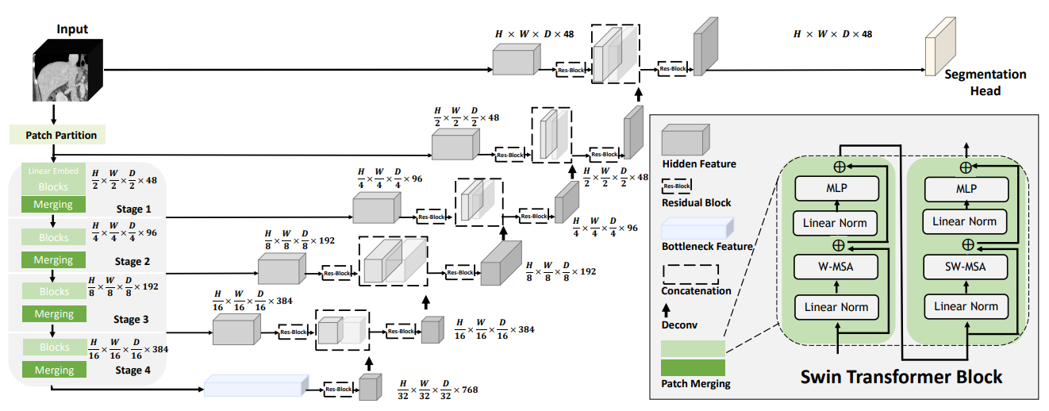
Introduction
Swin UNETR
U-shaped network, comprising an encoder and a decoder, is commonly employed in segmentation models
Encoder captures multi-scale information, Decoder integrates it to produce the segmentation map
Swin UNETR, utilizing Swin Transformer in the encoder, has gained prominence recently
Tang, Yucheng, et al. "Self-supervised pre-training of swin transformers for 3d medical image analysis.“ CVPR 2022
Notes:
Traditionally, U-shaped network called U-Net, comprising an encoder and a decoder, is commonly employed in segmentation models.
First, encoder captures multi-scale information about input medical image. In stage 1, it captures large scale image, so it can understand local features. and deeper and deeper by patch merging and feature extracting, it captures small scale image, so it can understand global features.
Second, decoder integrates multi-scale information of encoder and produce the segmentation map.
Recently, Swin UNETR, utilizing swin transformer in the encoder has gained prominence.

Slide 4
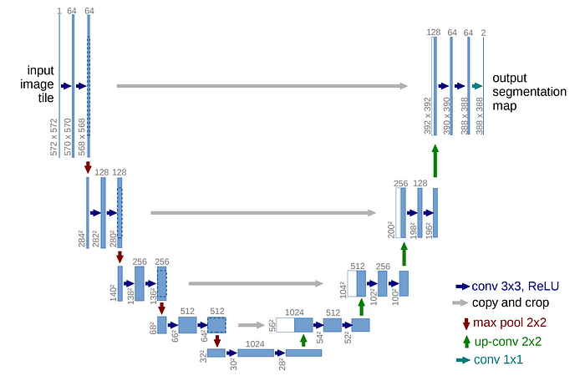
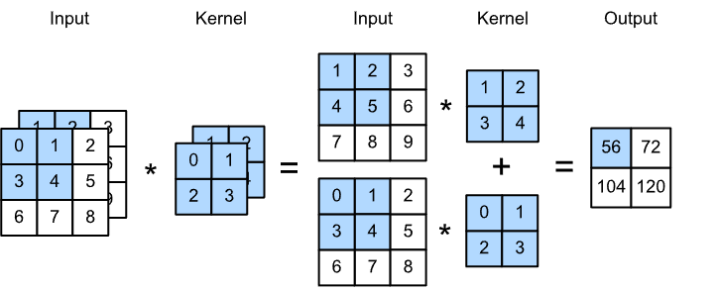
Introduction
Limitations of Traditional Approaches
Increasing channels in the encoder produces diverse contextual information, but focuses only on spatial features
Features from both the upper and lower stages are combined only once to acquire the local and global information necessary for segmentation
Ronneberger, Olaf, Philipp Fischer, and Thomas Brox. "U-net: Convolutional networks for biomedical image segmentation." MICCAI 2015
Notes:
However, such traditional approaches using U-Net architecture have limitations.
In U-Net encoder, channel count of feature maps is doubled by convolution or patch merging algorithm. and each channel means contextual information so model can get diverse contextual information!
But most models focus only on spatial features. For example, Convolutional encoders simply combine channel information during the convolutional process, so various contextual information of the input features can not be utilized properly. and Transformer encoder like Swin UNETR only perform spatial attention, so can understand spatial information by adding relevant spatial token but overlook crucial information on the channel axis.
Furthermore, features from both the upper and lower stages are combined only once by simply skip-connection. so decoder can lack the fused local and global information extracted in the encoder layers. and these results can lead to insufficient performance of segmentation.

Slide 5
Introduction
Contributions
Through dual attention, useful spatial and channel information is acquired at each stage of the model
Fusing various scales of information repeatedly, enabling fine and coarse-grained understanding
Structuring the model efficiently, decreasing the time and space complexity!
Spatial information
Fine-grained understanding
Tissue’s size, structure, composition, pattern, etc
Detecting small-scale tissue, intricate details, and subtle patterns.
Superior
Segmentation
Channel information
Coarse-grained understanding
Tissue’s color, texture, boundary, brightness, etc
Identifying large-scale tissue, contours, and prominent regions.
Notes:
To solve these problems, we proposed dual attention, and can get useful spatial and channel information.
You can think spatial information in our model is tissue’s size, structure, composition and pattern. and channel information is same as contextual information like tissue’s color, texture, boundary, brightness. we captured these information at each stage, and fuse all scales of information repeatedly, so can understand fine and coarse-grained features in medical image!
By understanding fine-grained features, we can detect small scale tissues more accurately, and by understanding coarse-grained features, we can detect large scale tissues well.
Besides, by structuring the model efficiently, we can decrease the time and space complexity and consequently conduct superior segmentation!

Slide 6
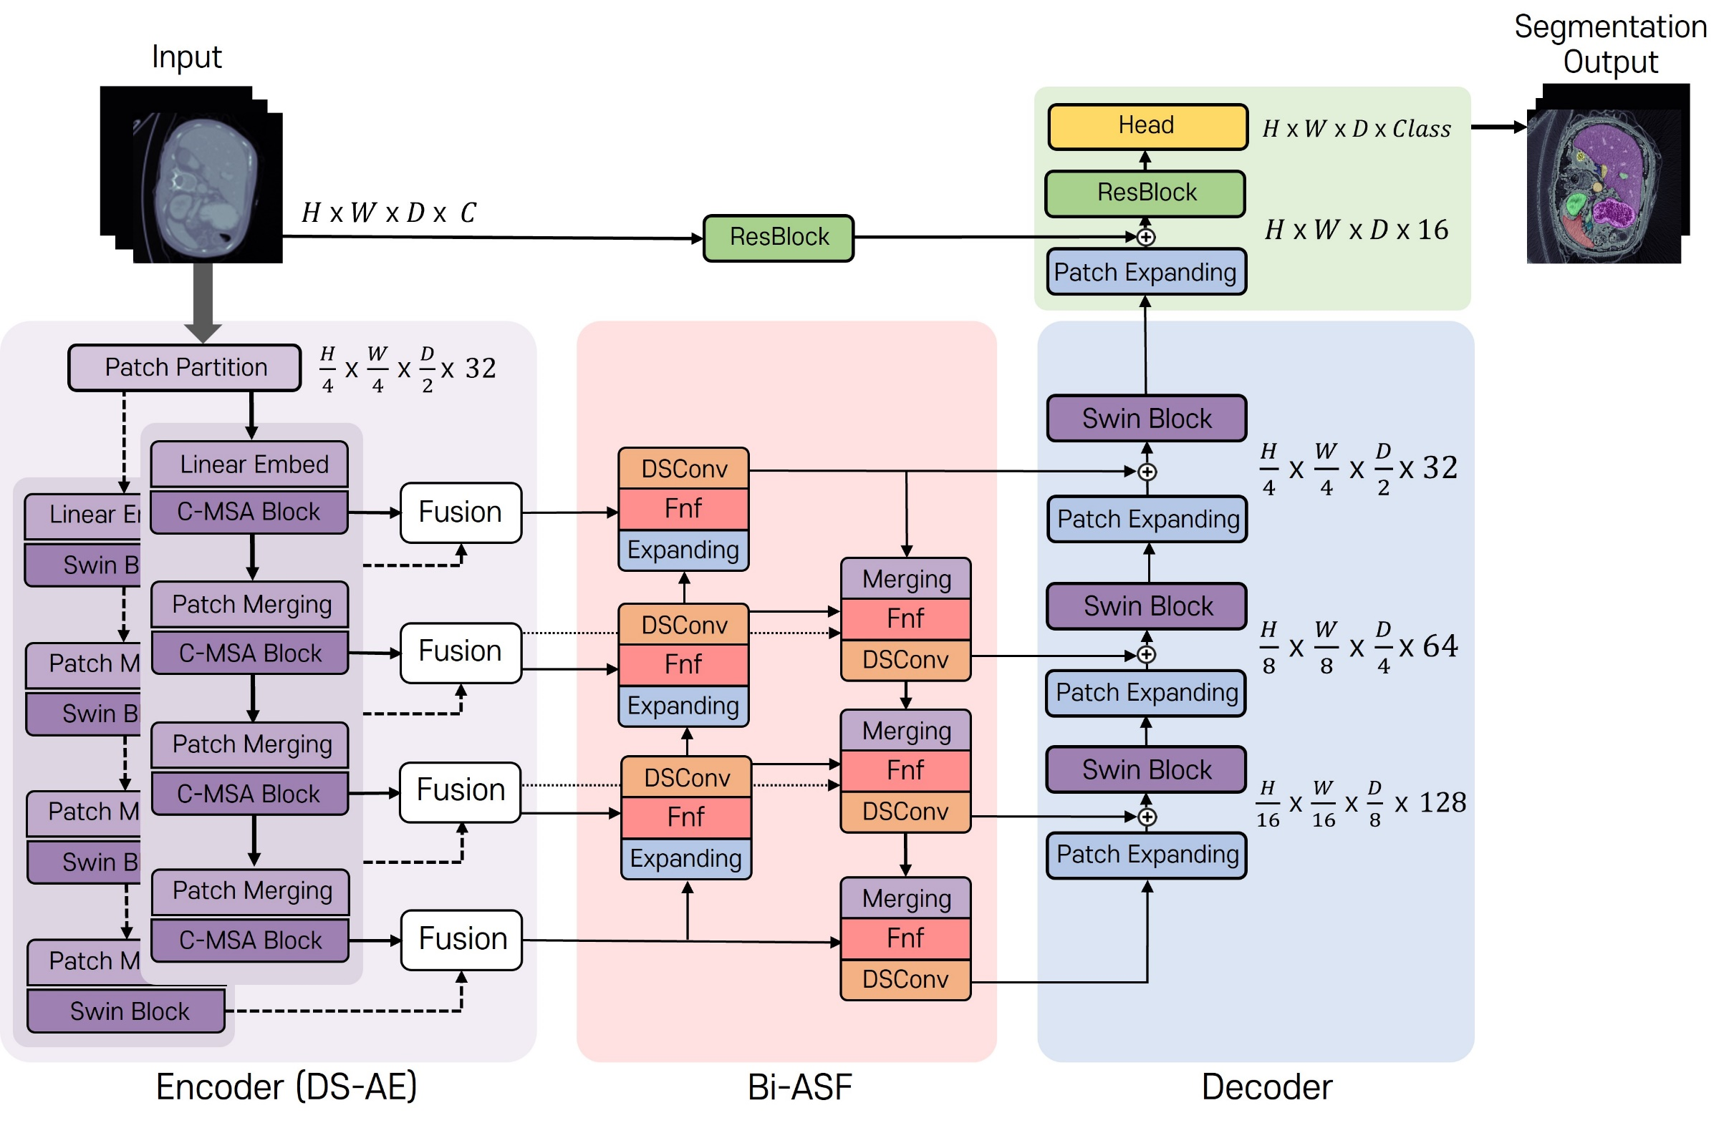
Method
Dual Stream Fusion U-Net Transformers
DS-AE performs spatial attention and channel attention in parallel and then fuses them together
Bi-ASF effectively integrates local and global information
DS-UNETR is a model constructed with a U-shaped network using two designed modules
Notes:
Our model have two designed modules.
one is Dual Stream Attention Encoder called DS-AE, and its module performs spatial attention and channel attention in parallel and then fuses them together!
The other is Bidrectional all scale fusion called Bi-ASF, and its module effectively integrates local and global information! and our model called DSUNETR is constructed with U-shaped network with two modules mentioned earlier.

Slide 7
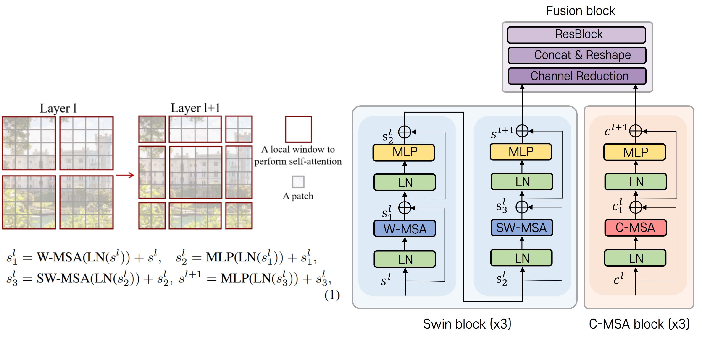
Method
Dual Stream Attention
Swin block conducts spatial attention to learn spatial relationships, acquiring spatial information
W-MSA: apply local attention for O (token) complexity!
SW-MSA: shift the window after each layer to transfer information between local windows
Liu, Ze, et al. "Swin transformer: Hierarchical vision transformer using shifted windows." ICCV 2021
Notes:
Dual stream attention module is constructed with swin block and C-MSA block and fusion block.
Firstly, swin block conducts spatial attention to learn spatial relationship per token and have two important mechanisms called W-MSA and SW-MSA.
W-MSA apply local window attention for O(token) complexity, and SW-MSA shift the window after W-MSA layer to transfer information between local windows.
we followed 3d swin transformer setting for acquiring spatial information efficiently!

Slide 8
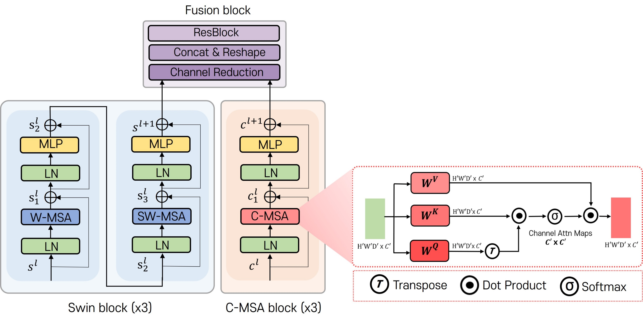
Method
Dual Stream Attention
C-MSA block conducts channel attention to learn channel relationships, acquiring contextual information
Channel Attention: generate channel attention map and consider only relevant channels
C-MSA: perform Channel Attention divided into multiple channels, improving efficiency!
Notes:
Secondly, C-MSA block conducts channel attention to learn channel relationships.
we edited vanilla transformer equation from QK^T to Q^TK and can generate channel attention map which can consider only relevant channels per token.
And by adding relevant channel information through multiplying Value and attention maps, we can utilize the contextual information of the input feature maps well.
And C-MSA operation perform channel attention divided into multiple channels, and can improve efficiency!
Finally, Fusion block integrate spatial and channel information by Residual block and output is transferred to Bi-ASF

Slide 9
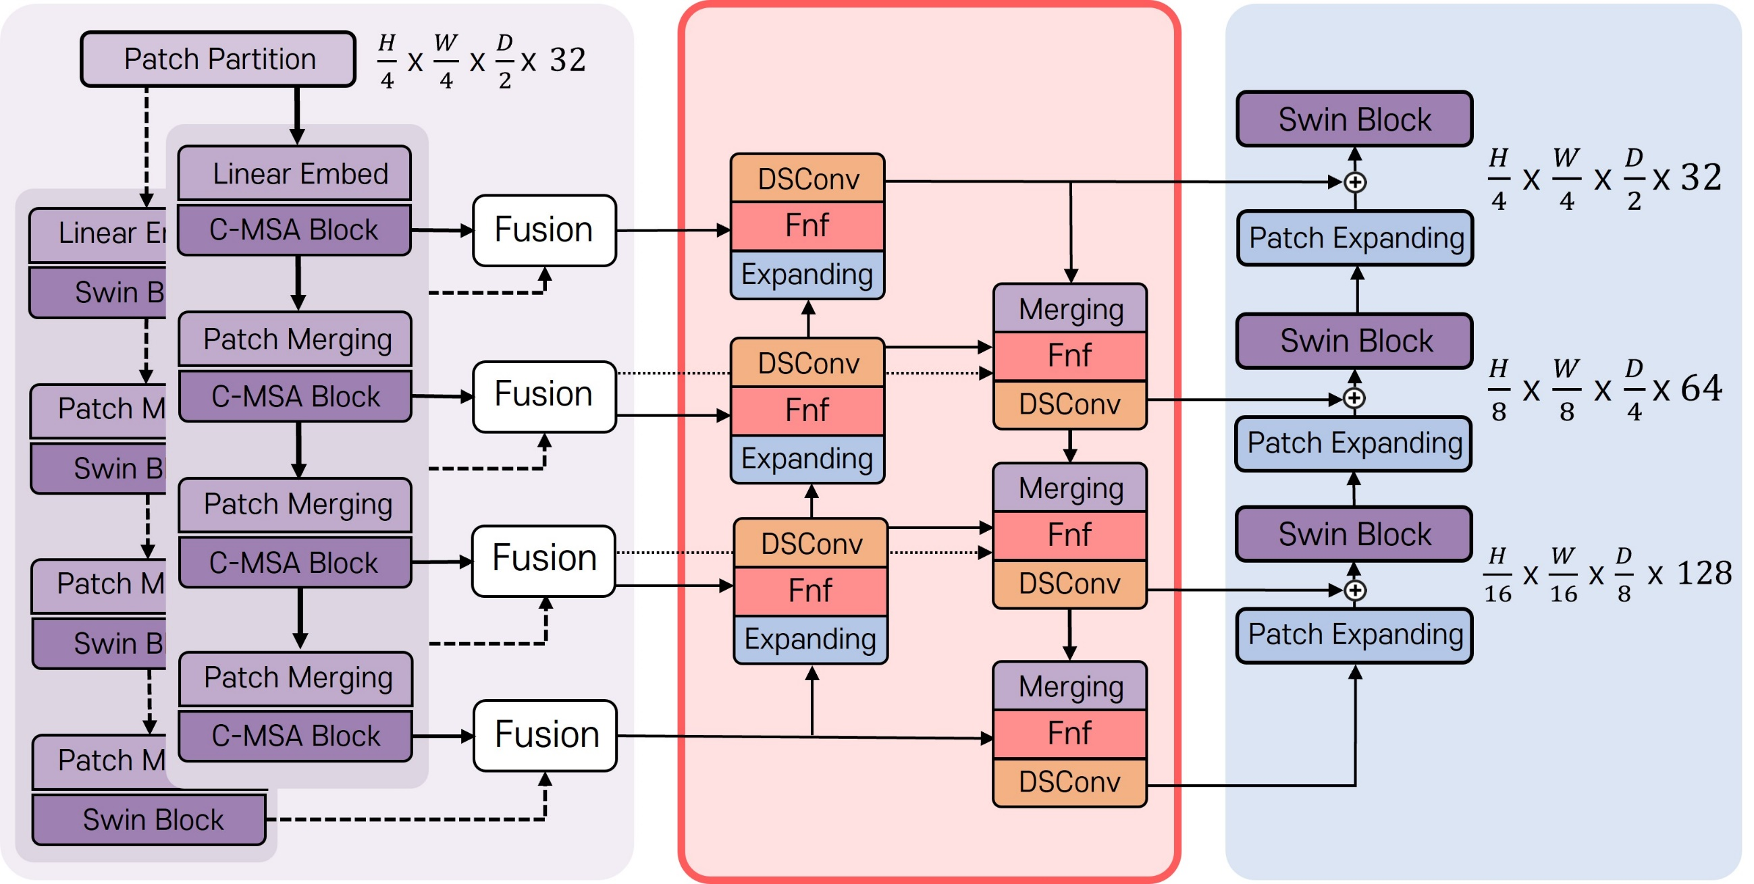
Method
Bidrectional All Scale Fusion
Bidirectionally fusing features of various scales, effectively leveraging both local and global information
Fnf: simple fusion method for combining many feature maps with different resolutions
Fused features are recalibrated through DSConv
Tan, Mingxing, Ruoming Pang, and Quoc V. Le. "Efficientdet: Scalable and efficient object detection.“ CVPR 2020
Notes:
Bi-ASF module fuses features of various scales bidrectionally. and can leverage both local and global information effectively!
we adapt Fast normalized fusion mechanism which is proposed in Efficientdet.
Fnf is very simple fusion method for combining many feature maps with different resolutions and its equation can be checked in right screen.
It make a weighted sum the learnable scalar w and feature map I, and devide it by the sum of w.
For example, F3 bu is third stage bottom up fusion feature and its input are third encoder feature, z9 and fourth feature z12, but z9 and z12’s resolution are different, so we resized z12.
After calculating fused features. we recalibrated it through depth-wise seperable convolution!
By performing this efficient structure once as bottom up and once as top down, we were able to solve the simple skip connection structure problem.

Slide 10
Results
Multi organ Image segmentation
Dice Score: A metric that combines precision and recall into a single measure
HD95: A method to determine distance between two sets
Proposed model achieved SOTA performance in average Dice Score, with the smallest Params and FLOPS
Notes:
Now, let me explain the experiment.
We experimented with various metrics on the multi-organ dataset to evaluate our model.
Dice Score is a metric that combines precision and recall into a single measure, and HD95 is 95% of Housdorff distance which is a method to determine distance between two sets. one is Ground truth, the other is predicted.
And our proposed model achieved state-of-the-art performance in average Dice Score with the smallest parameters and flops.

Slide 11
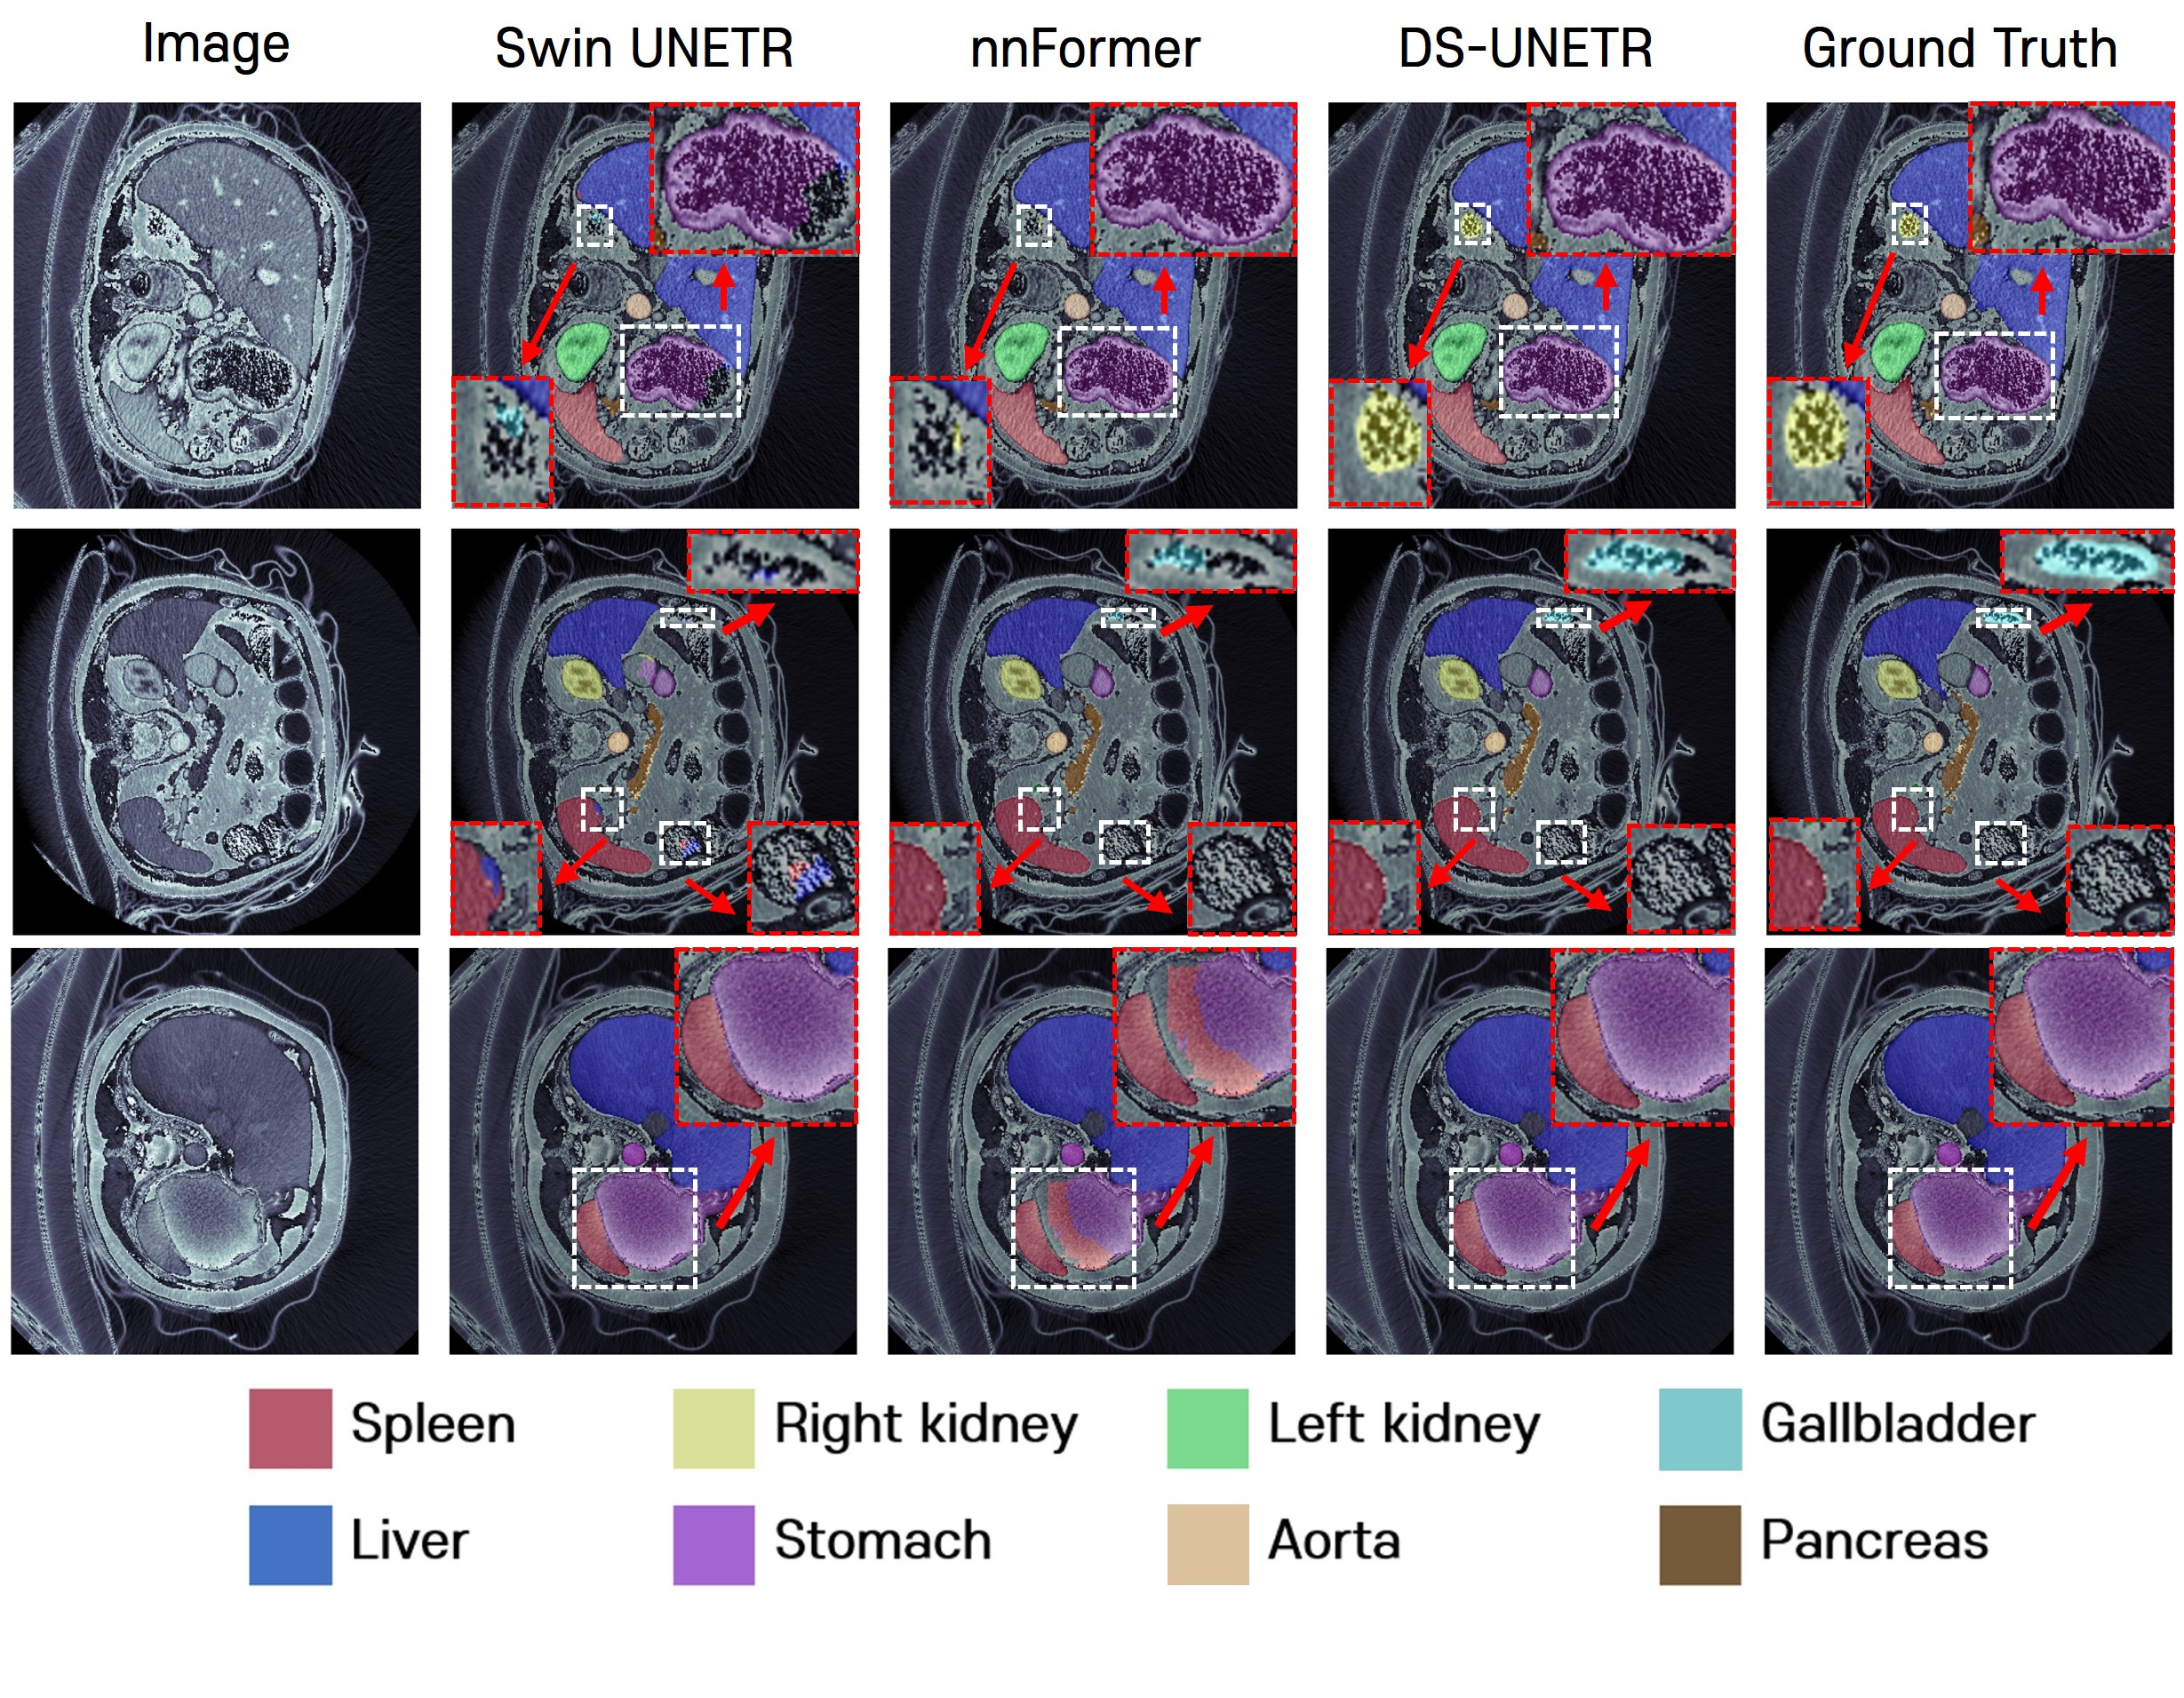
Results
Multi organ Image segmentation
High segmentation performance for the stomach, accurately identifies the right kidney
Does not overlap with other organs, and accurately identifies the gallbladder
Distinguish between Spleen and Stomach well without confusion
Notes:
For more detailed experiments, we also conducted a qualitative evaluation with famous models.
First, our model achieve high segmentaion performance for the stomach, and accurately identifies the right kidney.
Second, our model doesn’t overlap with other organs, and accurately identifies the small organ like gallbladder than other models.
Third, our model distinguish between spleen and stomach well without confusion.

Slide 12
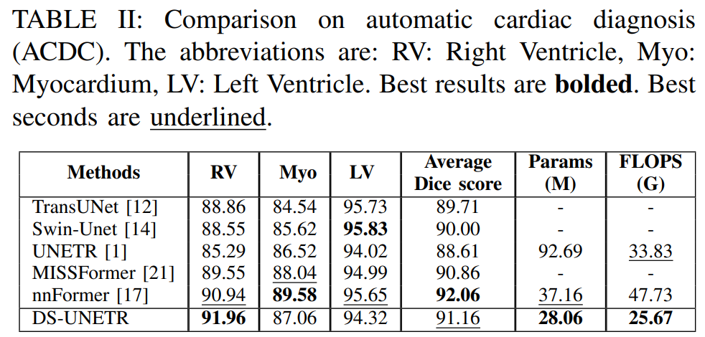
Results
Cardiac Image Segmentation
Achieved SOTA performance for Right Ventricle!
Average Dice Score achieves the second best performance
Commendable performance with fewer parameters and computational FLOPS compared to nnFormer
Notes:
And we also experiment with other dataset like cardiac medical images. and we achived the best performance on Right ventricle and second best performance on average dice score.
And our params and flops showed the least results.

Slide 13
Results
Ablation study
3D Swin Transformer in both the encoder and decoder of U-Net is utilized in the basic structure
Using the Bi-ASF module improves performance by 1% by better leveraging local and global information
Utilizing the DS-AE module improves performance by 2.58% through better utilization of contextual information
Notes:
Lastly, we conduct ablation study.
We used 3D Swin Transformer in both the encoder and decoder of U-Net for basic structure.
And using the Bi-ASF module improves performance by 1% by better leveraging local and global information.
Besides, utilizing the DS-AE module improves performance by 2.58% through better utilization of contextual information.

Slide 14
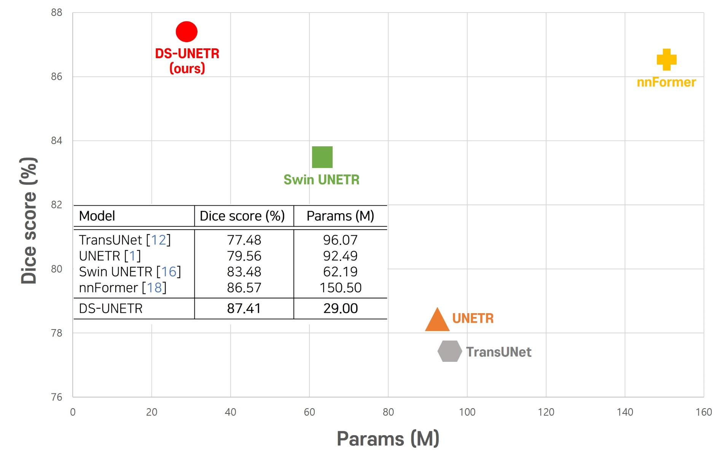
Conclusions
DS-UNETR
To enhance segmentation, propose effective utilization of channel information and feature fusion methods
Proposed model enables accurate and efficient medical image segmentation
Expect the proposed model to be utilized in various medical big data analyses!
Notes:
So, To enhance segmentation, we propose effective utilization of channel information and feature fusion methods.
Proposed model enables accurate and efficient medical image segmentation and we expect the proposed model to be utilized in various medical big data analyses!

Slide 15
Thank you
Notes:
Thank you!

